Slide 1


Matthew H Thomas
March 10, 2024

Slide 2

Outline
Executive Summary
Introduction
Methodology
Results
Conclusion
Appendix

Slide 3
Executive Summary – Methodology
Data collection methodology
Collected using SPACEX API and web-scraping.
Perform data wrangling
Used APIs, filtering, and data mean to prepare data.
Perform exploratory data analysis (EDA) using visualization and SQL
Perform interactive visual analytics using Folium and Plotly Dash
Perform predictive analysis using classification models
Used grid search to tune parameters and confusion matrices to evaluate models.

Slide 4
Executive Summary - Results
In exploratory analysis, we found:
The success rate has improved for the most recent flight numbers for all orbits.
Year after year, the success rate of the launches has shown a steady improvement.
Using interactive analysis, we found:
Almost 50% of the successful launches occurred at one site, the CCAFS LC-40 site.
However, upon further analysis, we found only 26.9% of its launches were successful.
The best performing predictive model was the Decision Tree model, which achieved an accuracy score of 88.9%.

Slide 5
Introduction
In this capstone, we took the role of a data scientist working for a new rocket company, Space Y.
Our job was to determine the price of each launch.
We did this by gathering information about SpaceX and creating dashboards for our team.
We also determined if SpaceX would be able to reuse the first stage of their rockets.
Instead of using rocket science to determine if the first stage will land successfully, we trained a machine learning model and used public information to make predictions about their successful launches.

Slide 6

Section 1

Slide 7
Methodology
Executive Summary
Data collection methodology
Collected using SPACEX API and web-scraping.
Perform data wrangling
Used APIs, filtering, and data mean to prepare data.
Perform exploratory data analysis (EDA) using visualization and SQL
Perform interactive visual analytics using Folium and Plotly Dash
Perform predictive analysis using classification models
Used grid search to tune parameters and confusion matrices to evaluate models.

Slide 8
Data Collection
For this capstone, we gathered most of the SpaceX launch data using the SpaceX REST API.
Using this API, we were able to download launch data including the rocket used, payload delivered, launch specifications, landing specifications, and landing outcome.
For additional launch data, we web scraped the Wiki pages related to the launches.
From these web pages, we obtained other launch data like the date and time of the launches, launch site, payload masses, target orbit, the customer and launch outcome.
8

Slide 9
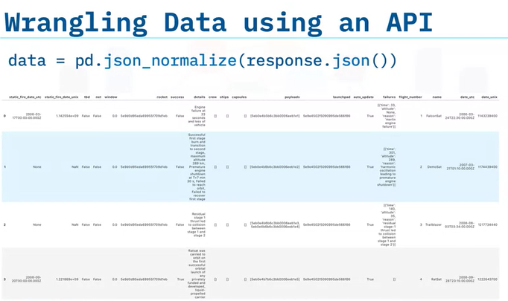
Data Collection – SpaceX API
The SpaceX REST API includes data about the rocket used, payload delivered, launch specifications, landing specifications, and landing outcome.
The launch data is located at the URL: api.spacexdata.com/v4/launches/past.
Because the data received via the API was in the form of a JSON object, we used the pandas json_normalize function to convert it into a data frame for exploratory analysis.
9
Link to notebook on Github

Slide 10
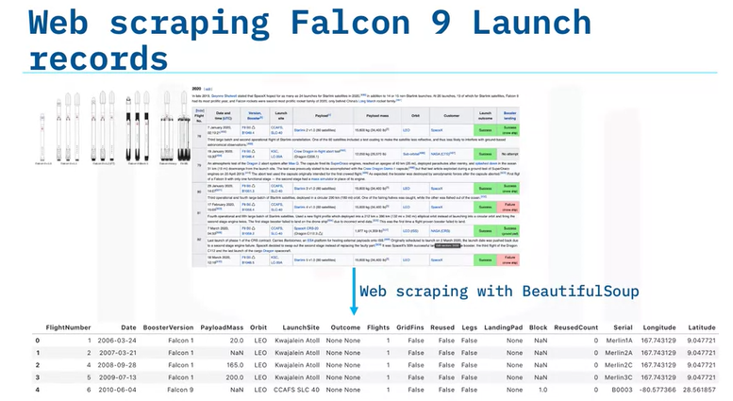
Data Collection – Web Scraping
To web scrape the Wiki HTML pages related to the launches, we used the Python BeautifulSoup package.
The downloaded data was formatted as tables.
We then parsed the data from those tables and converted them into a pandas data frame for further visualization and analysis.
10
Link to notebook on Github

Slide 11
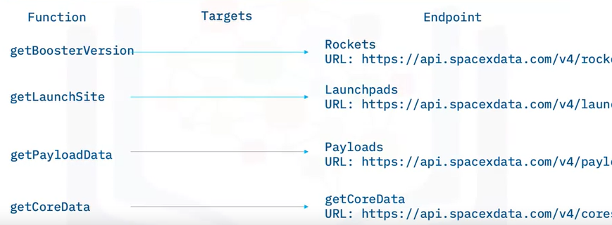
To transform this raw data into a clean dataset, we must address three issues:
Replacing id numbers with data.
Filtering Falcon 1 launch data.
Dealing with null values.
For some the columns, there is just an identification number, not actual data.
This means we will need to use the API again to target other endpoint data.
These endpoints include information about the booster, launchpad, payload, and core.
Data Wrangling

Slide 12
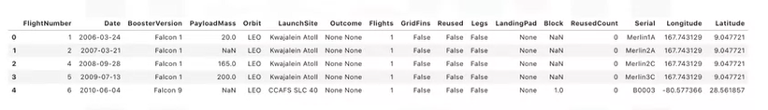
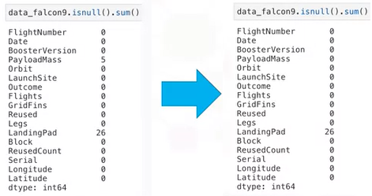
Data Wrangling
The raw data includes launch data about both Falcon 1 and Falcon 9 boosters.
Since we only want data about the Falcon 9 booster, we filtered the data to remove the Falcon 1 launches.
Finally, some of the data contains NULL values.
For the NULLS in payload mass data, we replaced missing values with the mean of the payload masses.
In the column with the landing pad data, the NULL values were retained, because they represent when a landing pad is not used.
12
Link to notebook on Github

Slide 13
EDA with Data Visualization
In the exploratory data analysis, we used three visualization types to identify success rate patterns in the data.
In two scatter plots, we examined the relationship between flight numbers and launch sites as well as to payload orbits, to identify any success rate patterns related to flight number.
In other scatter plots, we also analyzed the relationship between payload mass and launch sites and also to orbits, looking for success patterns related to payload mass.
To determine whether the orbit affects the success rate, we compared the success rates of orbits in a bar chart.
And finally, we used a line plot to identify any patterns in the success rate over time.
13
Link to notebook on Github

Slide 14
EDA with SQL
SQL Commands Used:
CREATE TABLE
Table Creation
SELECT
Selecting table columns
WHERE
Conditionals
LIKE
Contains specific sub-strings
GROUP BY
Divide into groups
ORDER BY
Sort rows
AVG
Find average value
SUM
Add values together
COUNT
Count rows
LIMIT
Restrict number of rows
Link to notebook on Github
14

Slide 15
Map Objects Used:
Marker
Used to mark and label each launch site.
Circle
Used to fill markers with color and pop-up identifying each site.
MarkerCluster
Used to group Markers identifying successful and failed launches at each site.
PolyLine
Used to mark proximity of railroads, highways, coast, and cities to sites.
MousePosition
Used to get latitude and longitude of proximity objects.
Build an Interactive Map with Folium
Link to notebook on Github
15

Slide 16
Build a Dashboard with Plotly Dash
The dashboard is divided into two main areas: the pie chart and the scatter plot.
For the pie chart, the user can select all the sites, or just one of the launch sites.
If all sites are selected, the pie chart compares the number of successful launches at all sites as a percentage.
If only one is selected, the pie chart will display the percentage of successful and failed launches at that site.
Given the launch site selection above, the scatter plot will display each of the successful and failed launches for each type of booster rocket at a given payload mass range.
The scrollbar allows you to change the range of payloads.
Link to Python file on Github
16

Slide 17
For the predictive analysis, we created four models with the data: Logistic Regression, SVM, Decision Tree, and k-Nearest Neighbor models.
The first strategy to improve results was to normalize the attributes used in the models.
To ensure my results overfit the data, we then divided the attributes and target data into training and test data with an 80/20 split.
For each model, we used grid search to identify the best hyper-parameters for the models with the training data.
Having identified the best estimator for each model, we then found the accuracy of the models on the test data.
We also reviewed the Confusion Matrices for each model to evaluate them.
Predictive Analysis (Classification)
Link to notebook on Github
17

Slide 18

Results – Exploratory Analysis
The VAFB SLC 4E and KSC LC 39A sites had the best success rate.
The KSC LC 39A site has the best success rate for all payload sizes.
The ES-L1, GEO, HEO, and SSO orbits all have 100% success rates.
The success rate has improved for the most recent flight numbers for all orbits.
For the heavy payloads, the Polar, LEO and ISS orbits were the most successful orbits.
The ES-L1, SSO, HEO, and MEO orbits were most successful for the smaller payloads.
Year after year, the success rate of the launches has shown a steady improvement.

Slide 19
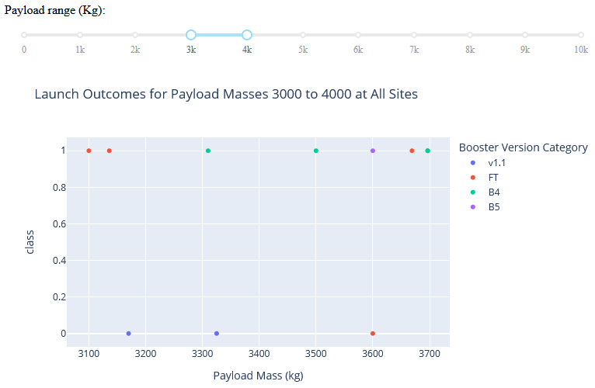
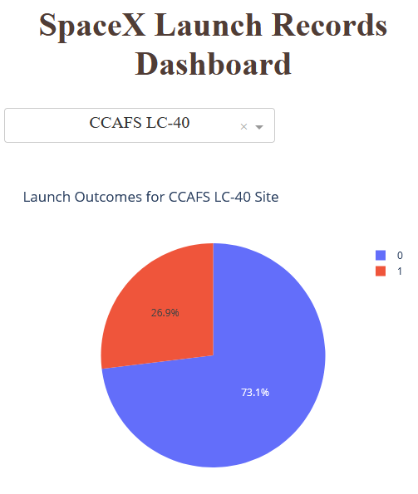
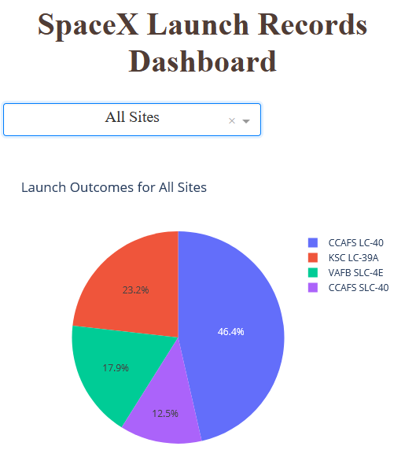
Results – Interactive Analytics
Using interactive analytics, we found almost 50% of the successful launches occurred at one site, the CCAFS LC-40 site.
However, upon further analysis, we found only 26.9% of its launches were successful.
So, to achieve a low success rate but still have the highest number of successes, it must have also had a high number of total launches.
In the payload range of 3,000 to 4,000 kg, there were more than twice as many successful launches as failures.
With this payload mass range, the most successes were evenly divided between the FT and B4 booster versions.

Slide 20
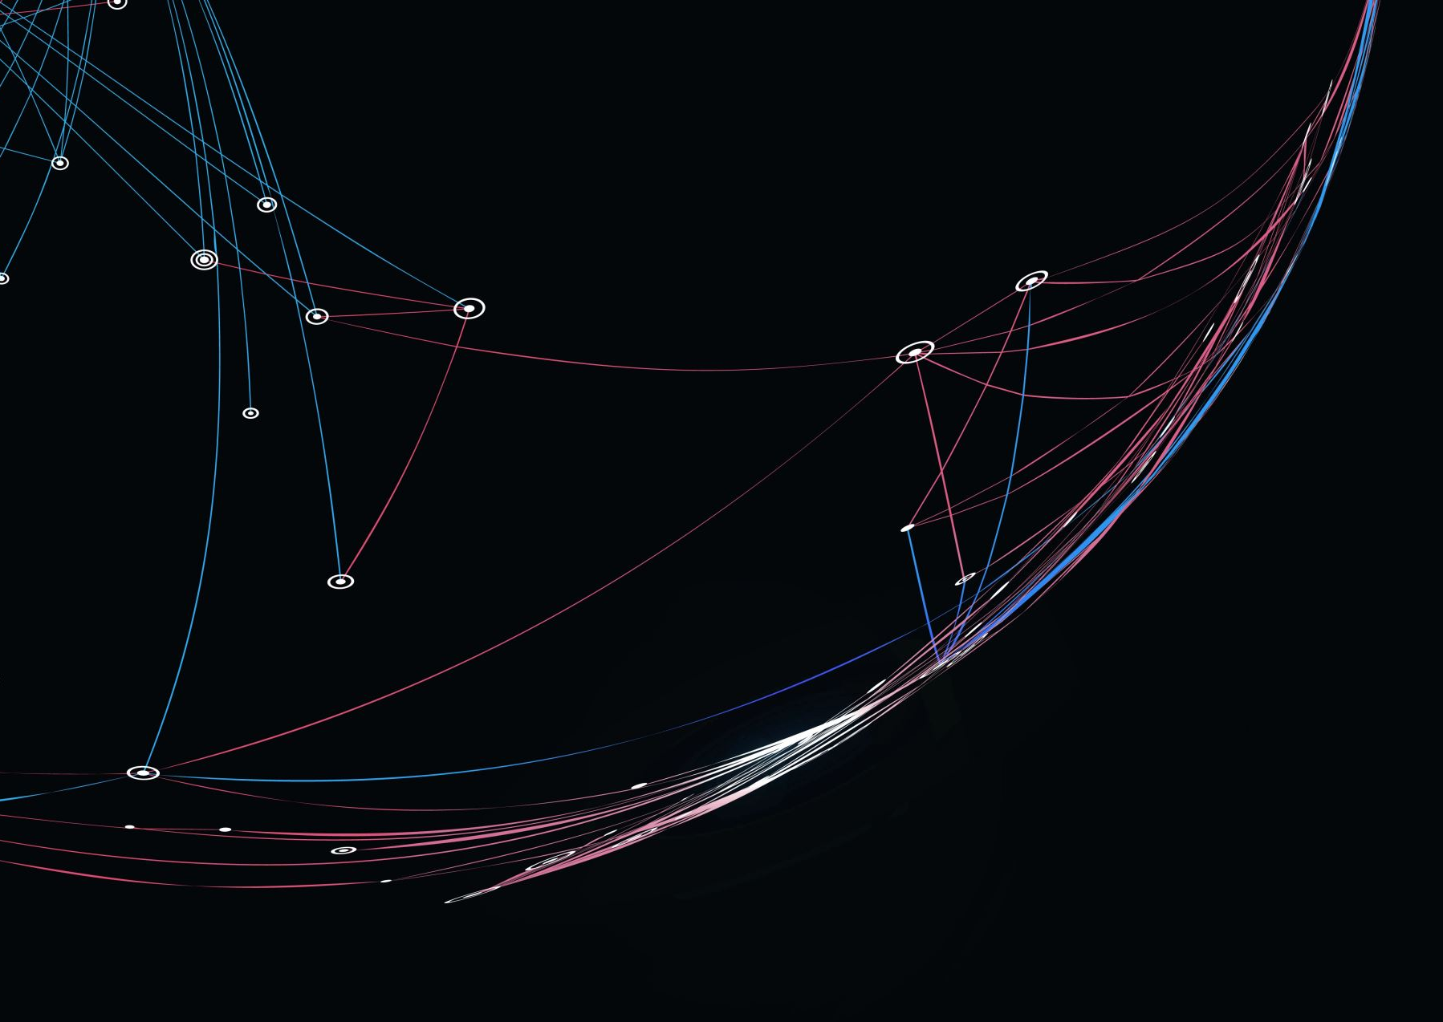
Results – Predictive Analysis
The best performing predictive model was the Decision Tree model.
Its accuracy score was 88.9%, more than 5% better than all of the other models.
On the test data, it was also the only model with one false positive and one false negative.
All of the other models had at least five false positives.

Slide 21

Section 2

Slide 22
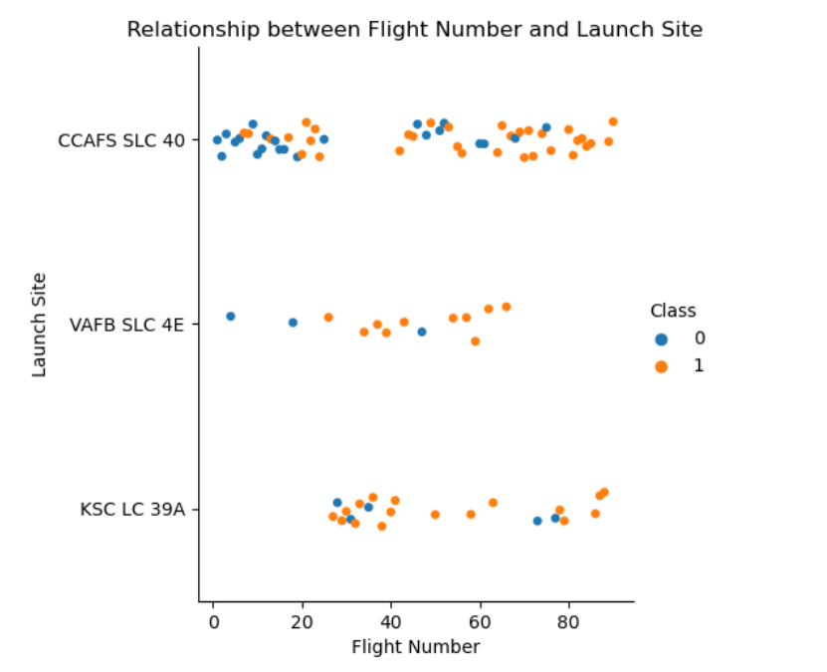
Flight Number vs. Launch Site
Overall, the VAFB SLC 4E and KSC LC 39A sites had the best success rate.
However, most of the launches have been from the CCAFS SLC 40 site, and its success rate has recently improved.

Slide 23
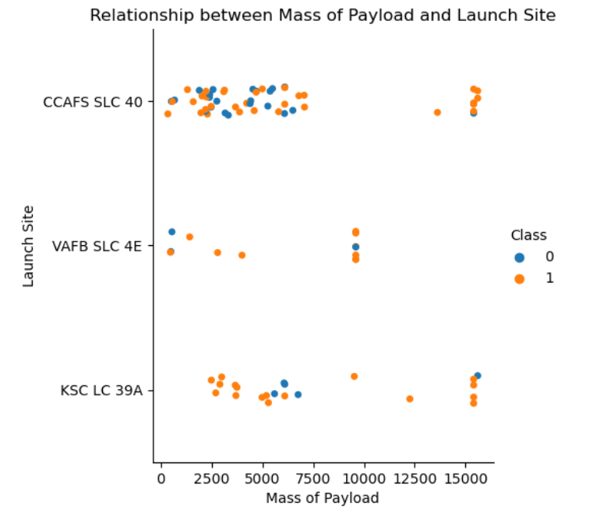
Payload vs. Launch Site
Overall, the KSC LC 39A site has the best success rate for all payload sizes.
The VAFB SLC 4E site also did well, but it had the fewest launches. And none of its launches had a higher-payload.
The CCAFS SLC 40 site did well for the higher payloads but had mixed results for the smaller payloads.

Slide 24
Success Rate vs. Orbit Type
The ES-L1, GEO, HEO, and SSO orbits all have 100% success rates.
The only orbit with no successes is the SO orbit.
The rest of the orbits have success rates between 52% and 86%.

Slide 25
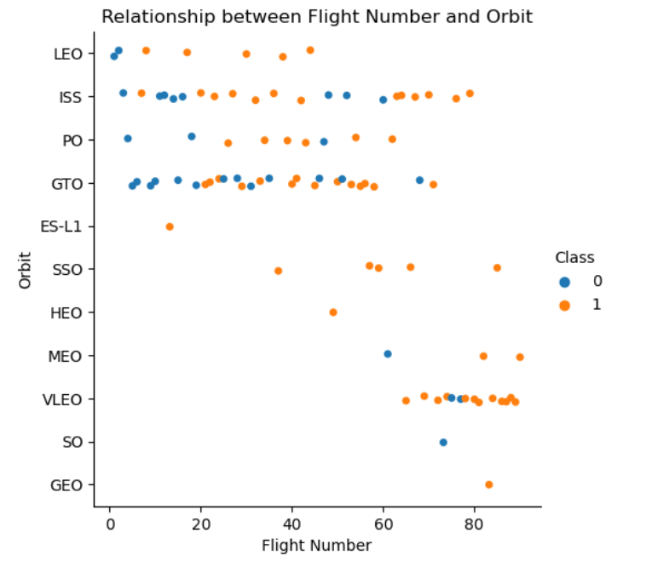
Flight Number vs. Orbit Type
For the LEO orbit, the success rate improved as the number of flights increase.
However, the success rate for the GTO orbit was mixed for all flight numbers.
Overall, the success rate has improved for the most recent flight numbers.

Slide 26
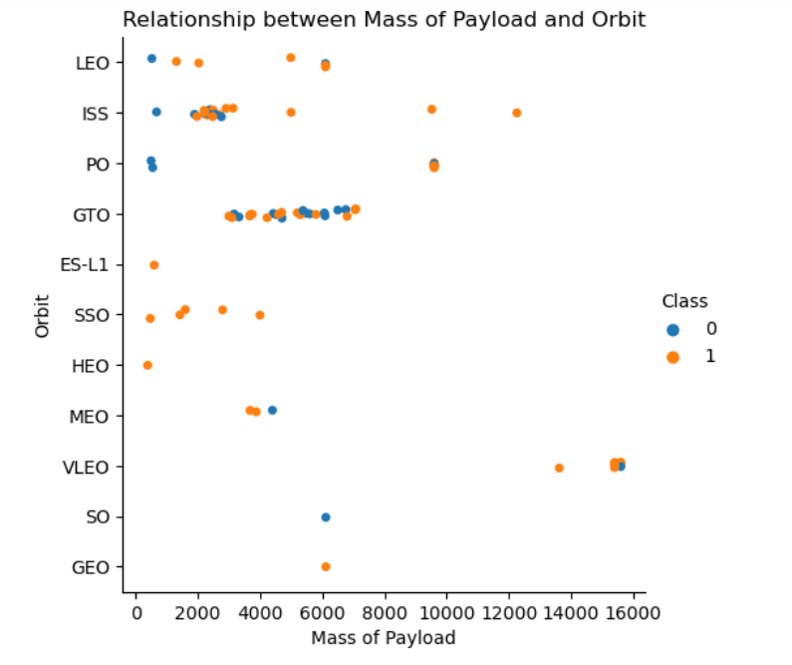
Payload vs. Orbit Type
For the heavy payloads, the Polar, LEO and ISS orbits were the most successful orbits.
The ES-L1, SSO, HEO, and MEO orbits were most successful for the smaller payloads.
The GTO results had mixed results for the low to medium payloads.

Slide 27
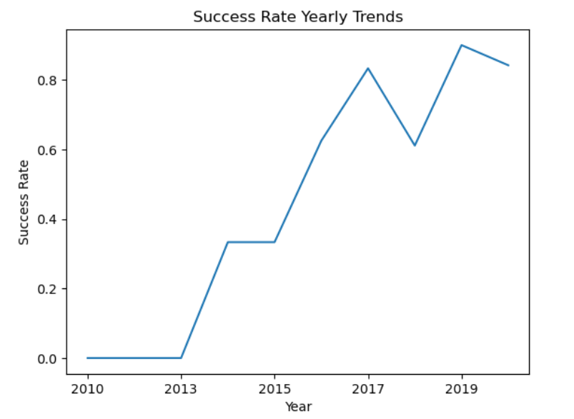
Launch Success Yearly Trend
In general, the success rate of the launches has shown a steady improvement.
One notable exception was in 2018. The success rate dropped from 83% in 2017 to 61% that year.
However, the success rate jumped up to 90% the next year.

Slide 28
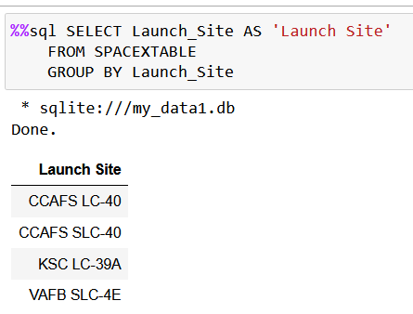
All Launch Site Names
There are four unique launch site names:
CCAFS LC-40
CCAFS SLC-40
KSC LC-39A
VAFB SLC-40
The SQL GROUP BY command was used on the Launch_Site column to find the names.

Slide 29
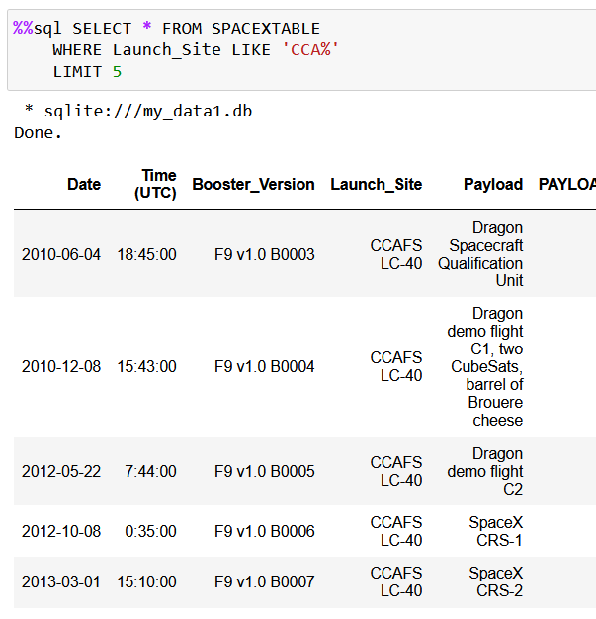
Launch Site Names Begin with 'CCA'
The SQL LIKE command was used in the WHERE command on the string ‘CCA%’ to find records for launch sites beginning with ‘CCA’.
The LIMIT command was used to display the first five records meeting this condition.

Slide 30
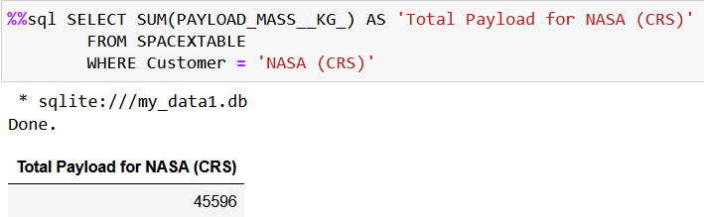
Total Payload Mass
The SQL WHERE command was used to find the records for the Customer = ‘NASA (CRS)’
To find the total payload of 45,596 kg, the SUM command was used.

Slide 31
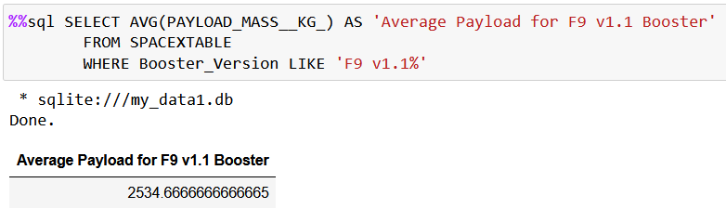
Average Payload Mass by F9 v1.1
The SQL LIKE command was used with the WHERE command to find launches using the F9 v1.1 boosters.
The AVG command was used to find the average payload mass of these launches 2534.67 kg.

Slide 32
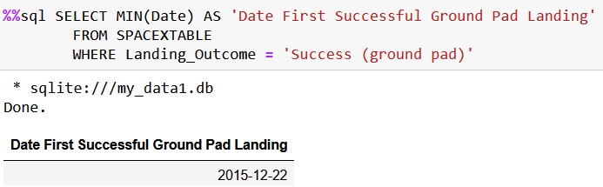
First Successful Ground Landing Date
The SQL WHERE command was used to find the records for the successful landing outcomes on a ground pad.
The MIN command was used to find the date of the first of these successful landing outcomes on December 22, 2015.

Slide 33
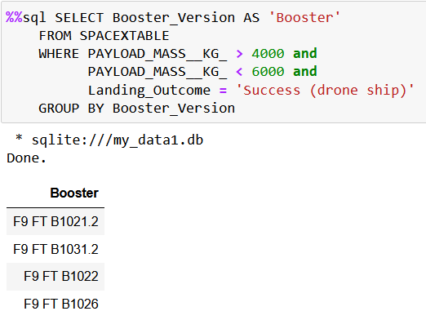
Successful Drone Ship Landing with Payload between 4000 and 6000
The SQL WHERE command was used to find the launches which successfully landed on drone ship and had payload mass greater than 4000 but less than 6000.
The GROUP BY command was used to find the booster versions used for these launches.

Slide 34
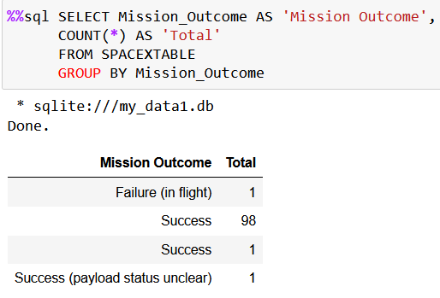
Total Number of Successful and Failure Mission Outcomes
The SQL GROUP BY and COUNT commands were used to calculate the total number of successful and failure mission outcomes.
Because one of the successful outcomes has a trailing space, it was considered another type of outcome.
Overall, there were 100 successes and only 1 failure.

Slide 35
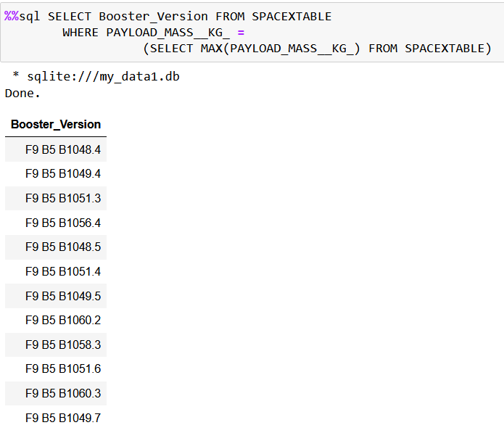
Boosters Carried Maximum Payload
To find the names of the boosters which have carried the maximum payload mass, a sub-query using the SQL MAX command was used within the WHERE command.

Slide 36
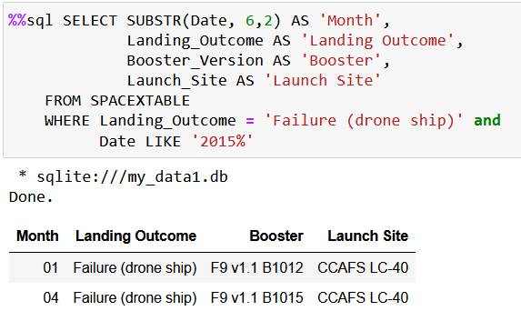
2015 Launch Records
The SQL LIKE command within a WHERE command was used to find the failed landings on a drone ship in 2015.
Their landing outcomes, months, booster versions, and launch site names were returned in a SELECT statement.
To return the month, a substring command, SUBSTR, was used.

Slide 37
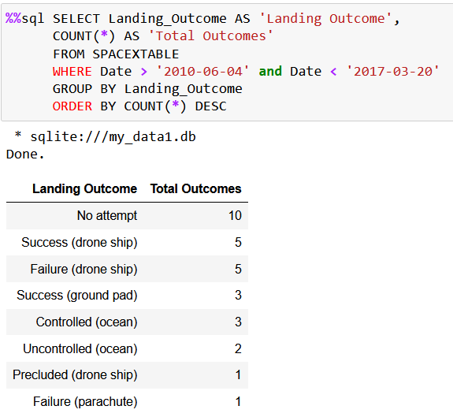
Rank Landing Outcomes Between 2010-06-04 and 2017-03-20
The SQL WHERE command was used to find the launches in this date range.
To organize the records by their landing outcomes, the GROUP BY command was used.
The COUNT command with the descending order option, DESC, was used to rank the count of landing outcomes.

Slide 38

Section 3

Slide 39
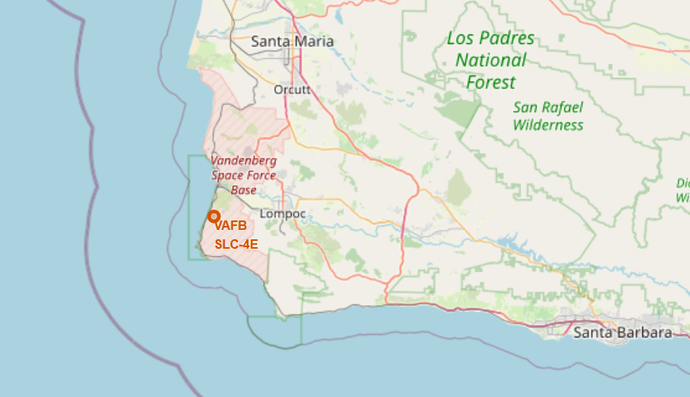
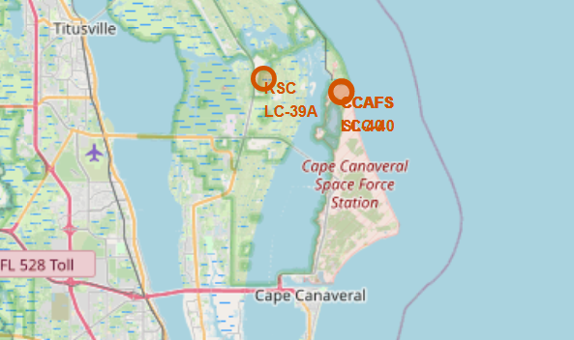
Location of Launch Sites
Using the Folium module, we were able to mark all four launch sites on a global map.
The two sites at Cape Canaveral are located close together and are hard to distinguish at this zoom level.

Slide 40
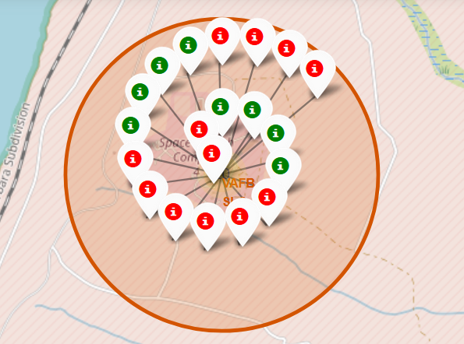
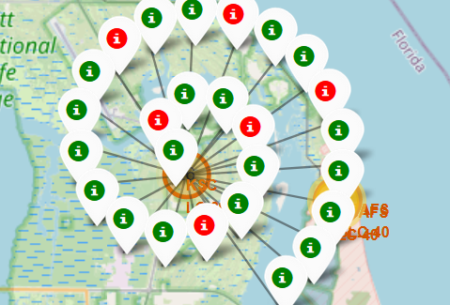
Launch Outcomes at Each Site
By marking successful launches in green and the failures in red, we can quickly compare the success rates of different sites.
Above, we can see that the VAFB SLC-4E site wasn’t as successful as the KSC LC-39A site.

Slide 41
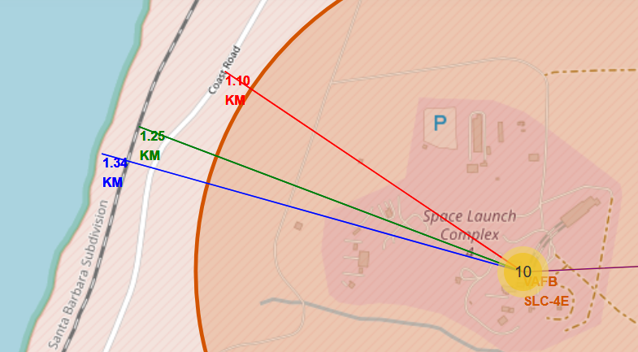
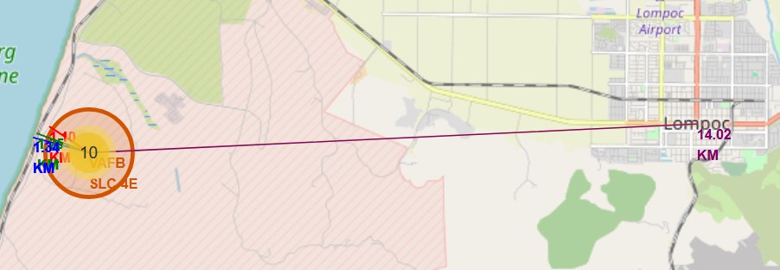
Launch Site Proximities to Resources and Populated Areas
All the launch sites are located close to railroads and highways, as well as the ocean. And they are located far from heavily populated areas.
For instance, VAFB SLC-4E is a little more than one kilometer from a highway, railroad and the ocean. However, it’s over 14 kilometers from the nearest city.

Slide 42

Section 4

Slide 43
Number of Successful Launches for All Sites
Almost 50% of the successful launches occurred at one site.
The CCAFS LC-40 site had twice as many successful launches compared to all the other sites.
The site with the fewest number of successes was the CCAFS SLC-40 site.

Slide 44
Success Rate for CCAFS LC-40 Site
For the launch site with the highest number of successes, CCAFS LC-40, only 26.9% of its launches were successful.
This indicates the site had more launches than the other sites, because only about a quarter were successful.

Slide 45
Success Launches for 3k - 4k Payloads by Booster
In the payload range of 3,000 to 4,000 kg, there were more than twice as many successful launches as failures.
The most successes were evenly divided between the FT and B4 booster versions.

Slide 46

Section 5

Slide 47
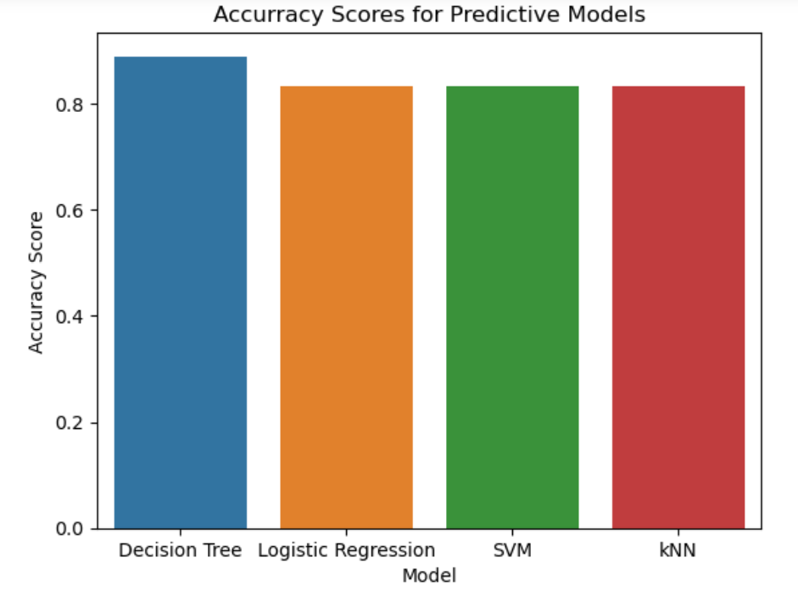
Classification Accuracy
Although the k-Nearest Neighbor, Support Vector Machine, and Logistic Regression models all scored 83.3% on the test data, the Decision Tree model had the highest accuracy score of 88.9%.
47

Slide 48
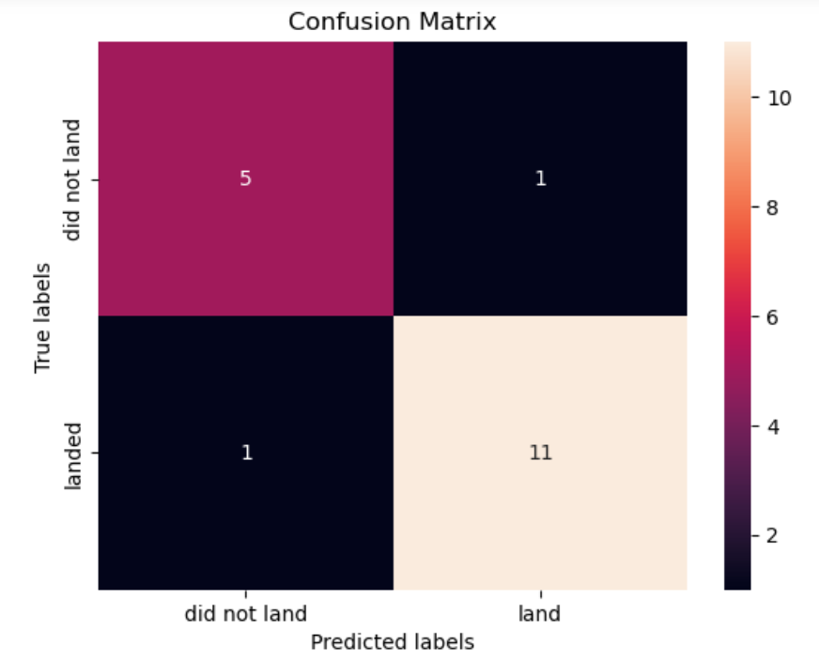
Decision Tree Confusion Matrix
On the test data, the Decision Tree classifier only had 1 false positive and 1 false negative.
However, the sample size is small, and further testing should be done to validate the model.
48

Slide 49
Conclusions
Use the KSC LC 39A Launch Site on Merritt Island, Florida
Target ES-L1, GEO, HEO, and SSO Orbits
Focus on Payload Masses between 4k and 6k kg
Use One of These Boosters: F9 FT B1021.2, B1031.2, B1022, or B1026

Slide 50

Appendix
Link to database used for SQL queries

Slide 51


